Slide 1
Northwestern / D65 Research Update
September 10, 2019

Slide 2
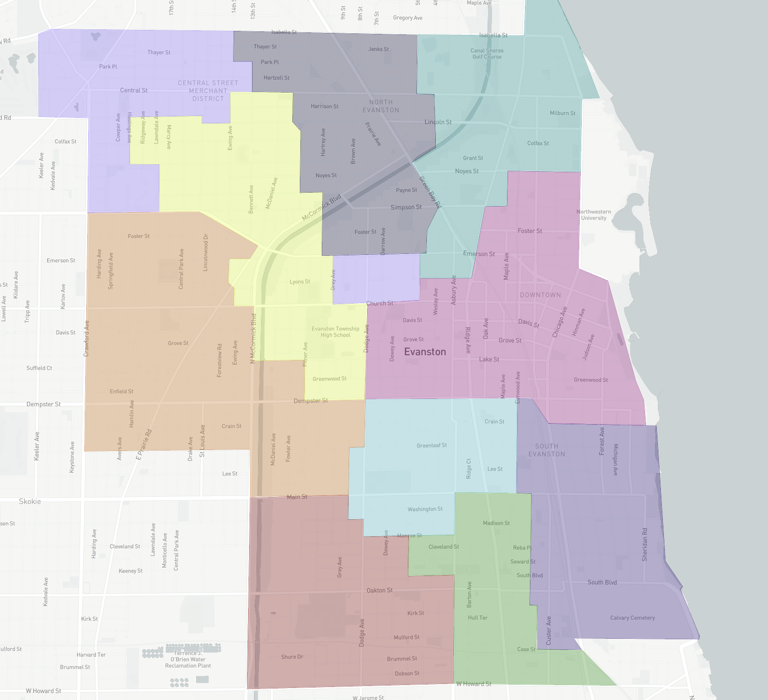
Meeting agenda
Overview of districting project
Capabilities, assumptions and data discussion
Next steps

Slide 3
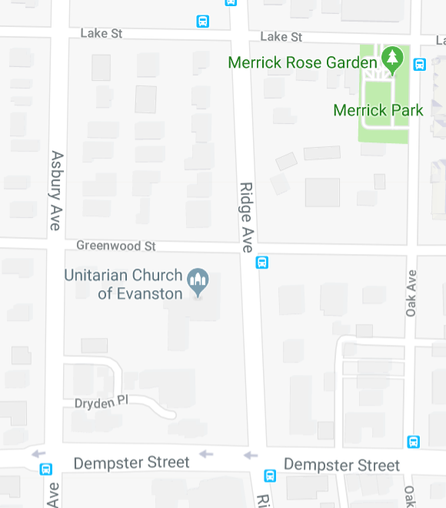
What we mean by ‘block’
Polygons comprised of street segments for which it is reasonable to assume that all residences within the polygon would be assigned to the same school
Collapse dead-ends into polygon
Include side-of-street when defining the border of a polygon
Shapes may be defined by 3, 4, 5,… street segments depending of network
Block A
Block C
Block B
Block D

Slide 4
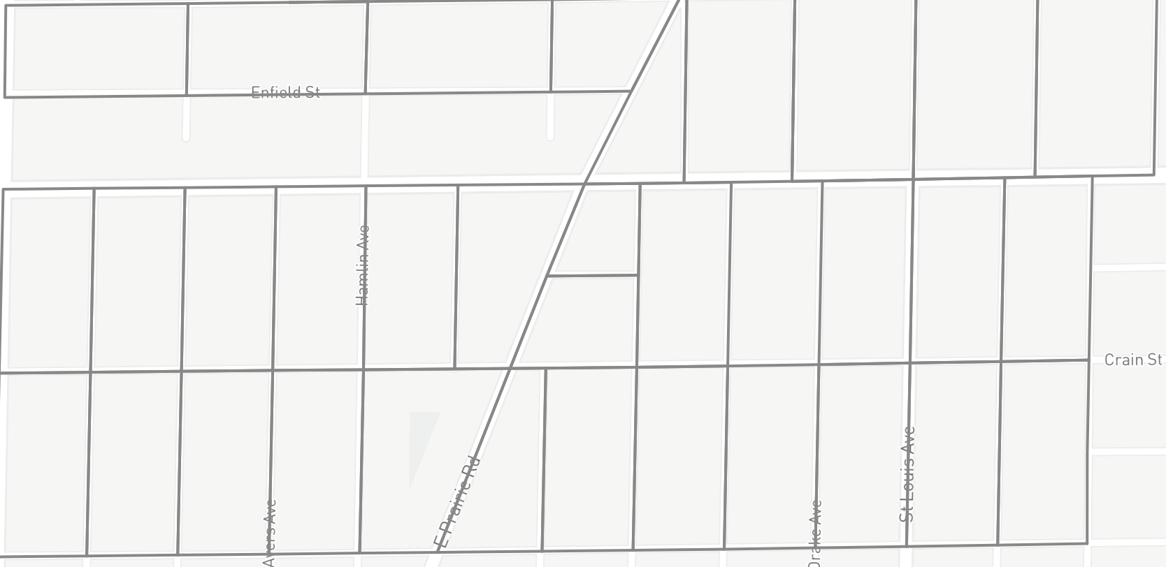
Example from the data

Slide 5
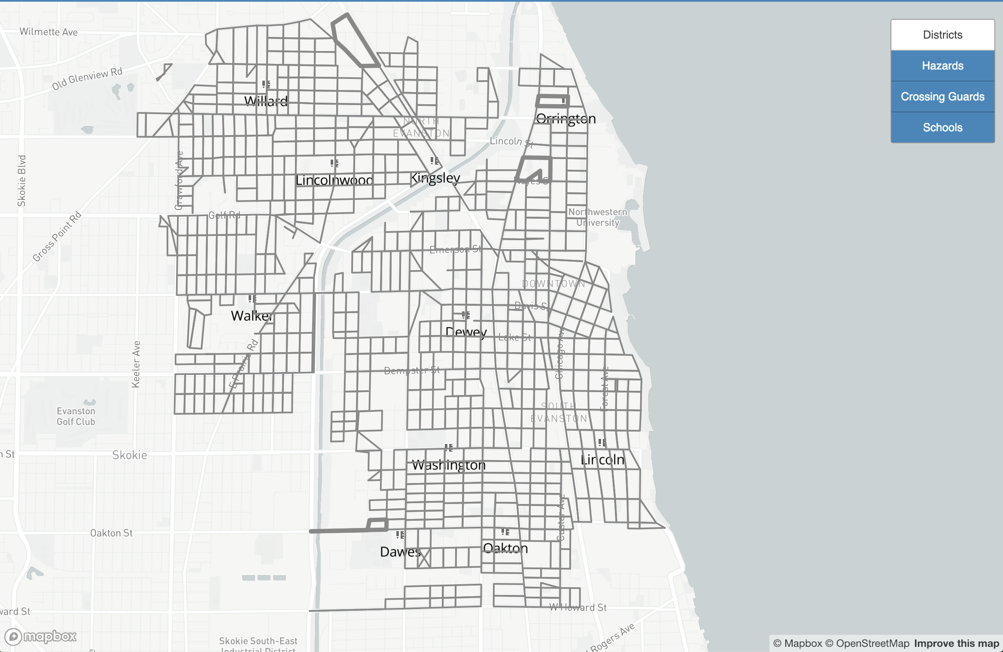
Visualizing the blocks
We can use color coding to assign each block to the school it is assigned to

Slide 6
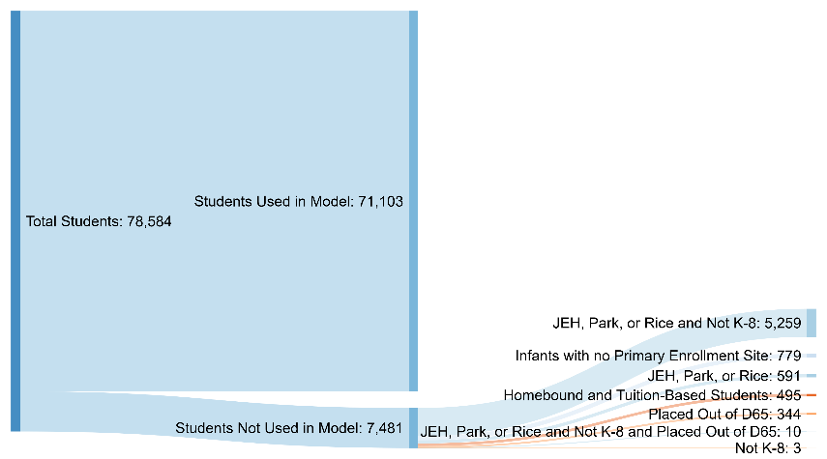
Making the research data set

Slide 7
Aggregating the data
71,103 student-years included in research
Link addresses to 828 blocks
Link 10 years to 10 2-year bands
Aggregate by location (blocks) and time (year bands) for 8,280 block-year bands
Count students and subsets by block-year band
If at least 10 students
report counts
If fewer than 10 students
count combined with nearest blocks
If at least 10 students
report combined counts
If fewer than 10 students
aggregate remaining
4,446 group-year band counts and 2,428 block-year bands with no students reported

Slide 8
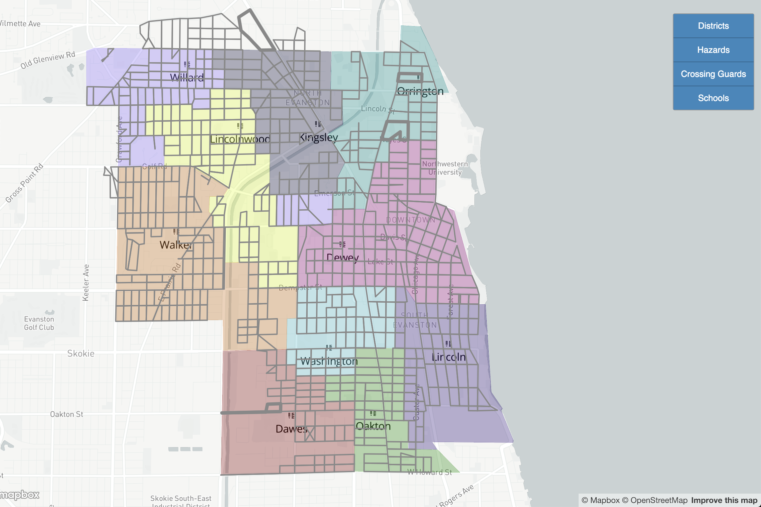
Assigning blocks to schools

